Slide 1
Welcome!

Slide 2
The Solar System
Mike

Slide 3
Introduce myself
Name: Mike
Age: 15
Hobby: Playing football

Slide 4
Introduce yourself

Slide 5
Schedule
1) Watch Crash Course Kids
2) Guided reading, khan academy article
3) Go through interactive website, Solar System Explorer
4) Watch this video: https://www.youtube.com/watch?v=ErUZVWUP0c4

Slide 6
Icebreaker
Would you rather be in very hot summer weather or in freezing, snowing winter weather

Slide 7
The Sun
The Sun is the star of the solar system (actually it’s not a planet).
It is a five billion-year-old big ball of super hot gas.
It contains several parts.
  The core: It’s about 15 million ℃ (27 million ℉)
  The surface: Much cooler than the core (10,000 ℉), but still very hot.
It is so huge that you can line up over 100 Earths along the face of it.
It is similar to other stars, but because it is way more closer to the Earth, it becomes much larger than other stars.
It provides us heat and light that supports plants to grow and animals to live.

Slide 8
The Sun
Q: How does the Sun’s energy gets from its core to the Earth.
  First, the energy is created in its super-hot core.
  Then, it takes the energy 100,000 years to travel from the core to its surface.
  Finally, the energy travels as light and heat all the way to Earth.

Slide 9
The Solar System
The solar system locates in the Milky Way.
It formed from a huge cloud of gas and dust about 4.6 billion years ago.
It consists of the sun, eight planets and their moons, an asteroid belt, and other celestial bodies such as comets.
The planets closer to the Sun are called “inner planets”, while others are called “outer planets”. The inner and outer planets are separated by the asteroid belt, a ring-shaped region containing many rocky bodies called asteroids.

Slide 10
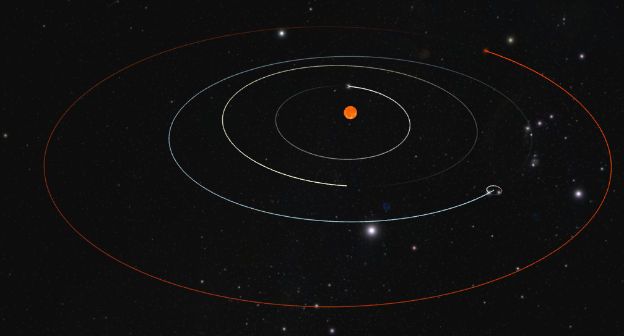
Planets of the Solar System
The four planets closest to the sun—Mercury, Venus, Earth, and Mars—are called the inner planets.
These planets have thin atmospheres, solid surfaces, few or no moons, and no rings.
Mars
Mercury
Sun
Venus
Earth
Screenshot from https://projects.wwtambassadors.org/solar-system-explorer/#

Slide 11
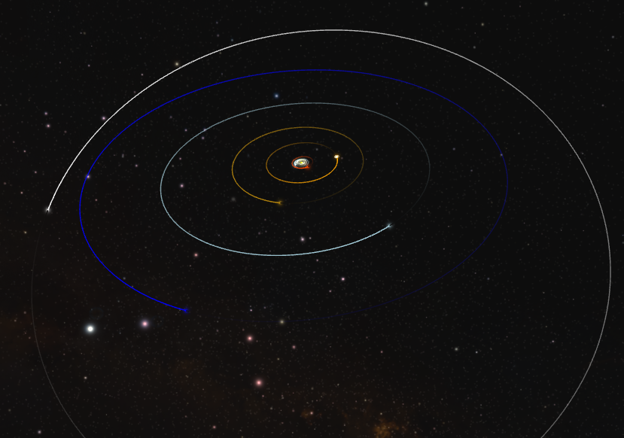
Planets of the Solar System
The four planets farthest from the sun—Jupiter, Saturn, Uranus, and Neptune—are called the outer planets.
These planets have thick atmospheres, no solid surfaces, and many rings and moons.
Inner Planets
Jupiter
Saturn
Pluto
(not a planet)
Uranus
Neptune
Screenshot from https://projects.wwtambassadors.org/solar-system-explorer/#

Slide 12
Mercury
Mercury is the closest world to the Sun.
It is a cratered, airless rock that endures blistering heat by day and frigid cold by night.
Among all the planets, Mercury holds the title of being the smallest in the solar system, with a diameter of just about 4,880 kilometers.
It has no rings and virtually no atmosphere.

Slide 13
Venus
Similar in size to Earth, Venus is a hostile world cloaked in thick, sulfuric clouds.
Its runaway greenhouse effect makes it the hottest planet, with surface temperatures that can melt lead.
Venus rotates very slowly and in the opposite direction to most planets, but it has no rings and no known moons.

Slide 14
Earth
This is our home planet. It is the third planet it the solar system.
It spin upon its axis by a day.
It takes the Earth a little more than a year to orbit the Sun.

Slide 15
Mars
The fourth planet from the Sun is also called the Red Planet, due to the abundant red iron oxide rust covering its soil.
It has lots of volcanos, including the highest mountain in the solar system.
Although we have a lot of missions related to Mars, no one has actually stepped on Mars yet.
Mars has two tiny, irregular moons and no rings.

Slide 16
Jupiter
Jupiter is the largest planet in the solar system, with a diameter over 11 times that of Earth.
This gas giant is famous for its Great Red Spot, a storm larger than our entire planet.
Also, it has lots of moons. Scientists have already discovered more than 115 moons.
Jupiter also has a ring, made mostly of dust from its inner moons.

Slide 17
Saturn
Saturn is the second-largest planet.
It is so light that it could theoretically float on water.
Saturn has over 140 known moons, with Titan being larger than Mercury.
Its ring system is the most prominent and easily visible, making it one of the four planets in our solar system that have rings.

Slide 18
Uranus
Uranus is light blue because of its atmosphere.
It is different because it has an extreme axial tilt—it rotates on its side, effectively rolling around the Sun like a cosmic ball.
Uranus has a faint, dark ring system, placing it among the four ringed planets, and it hosts 27 known moons.

Slide 19
Neptune
The farthest full planet from the Sun is Neptune.
It has the fiercest winds in the solar system, reaching over 2,000 kilometers per hour.
It was the first planet discovered using mathematical calculations rather than direct observation.
Neptune also has rings and it has 16 known moons, with Triton being the largest.

Slide 20
Pluto (not a planet anymore)
Pluto is a dwarf planet resides in the Kuiper Belt beyond Neptune.
It has an extremely thin atomsphere, including mainly nitrogen with a little methane and CO.
It was reclassified as a dwarf planet in 2006 by the IAU because it failed to clear other planets using the same orbit with it.

Slide 21
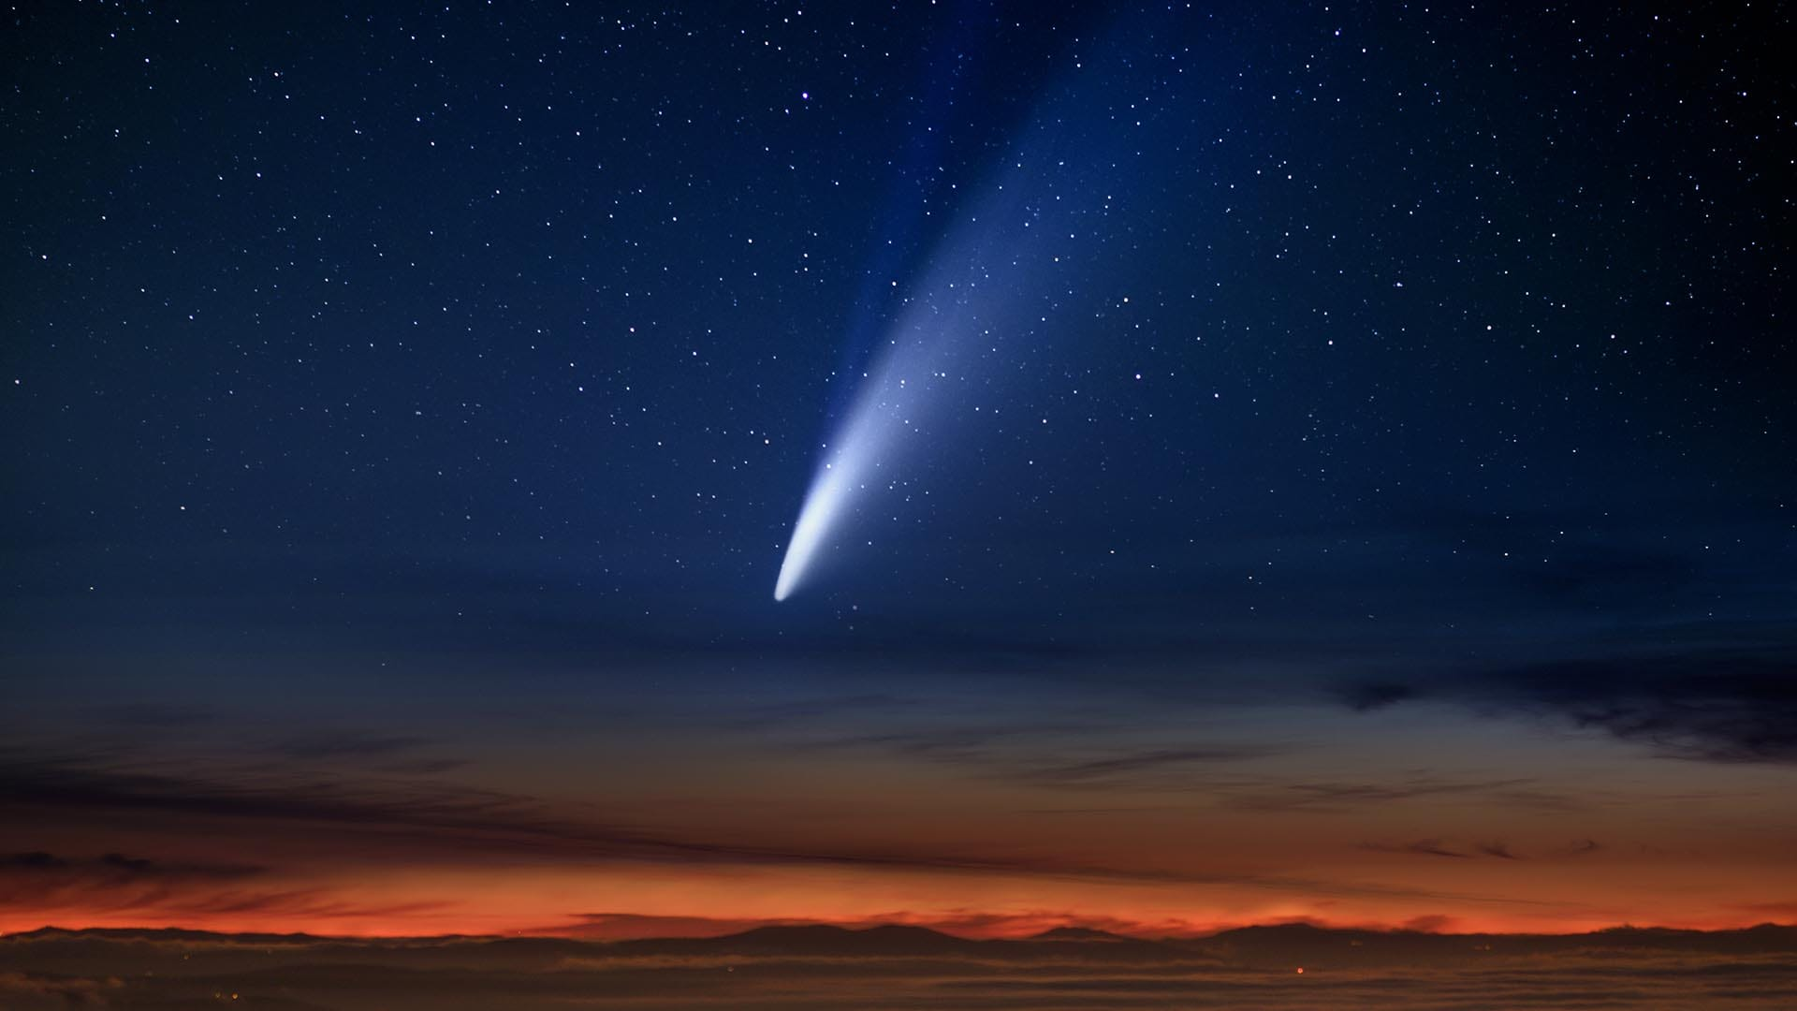
Comets
They are dusty, icy bodies that orbit the sun beyond Neptune.
Both comets and asteroids are much smaller than planets.
The photo here shows a comet.
Source:https://starwalk.space/gallery/images/upcoming-comets-2023/1920x1080.jpg

Slide 22
Break Time
We’ll be back at 5:50PM

Slide 23
Kahoot Quiz
Game PIN: 08865658
Link: https://kahoot.it/challenge/08865658

Slide 24
Checkout
What planet did you find most interesting? Why?

Slide 25
Thanks for listening
See you next week!

